Slide 1
Pyramid Productions Business Case
By Russell Powers

Slide 2
Toc
Overview

Slide 3
Overview

Slide 4
Sales Cycle
20%
Lead Gen
Prospect
Discovery
Consultation Call
Opportunities
Projects
Revisions
Interview
Kickoff Call
Script Call
SOW
Budget
Production Tasks
Timesheets/Cost
CRM
Proposal
40%
80%
60%

Slide 5
Fy17 Goals

Slide 6
Fy17 Sales Target

Slide 7
Analytics & Reporting
Daily and Weekly Analytics
KPI
Capacity $ and % ($6000, 80%)
Time to complete one
Time to complete 4
time to complete 8
100 completed projects
2. Report Creation

Slide 8
Recommendation (Sales Cycle Management) [Graph this][Dashboard chart step by step]
Update the CRM to allow for Pipeline management, reporting and dashboard integration.
Integrate BANT concept and 0% to 100% Lead Qualification.
Integrate Sales Cycle
Integrate Maven Link

Slide 9
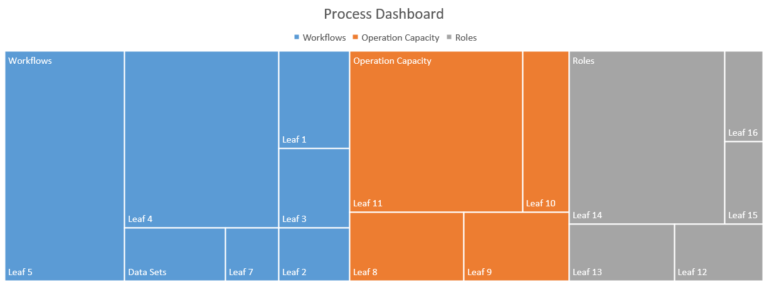
Process Unit Test (Target)
N = 1 – 7
i = 101
Demo
THead
Interview
Sales
Production Manger
Owner
Managing Director
Office Manager
Account Manager
Producer
Script writer
Creative lead
Anamation lead
Editor lead
Intern
Bookkeeper
Client
Initiating Processx
Planning Process
Maven link Template
Executing Process
monitoring & controlling Process
Custumize template
Scedule tasks
Lead Gen
Prospect
Discovery
Consultation Call
Opportunities
Projects
Revisions
Interview
Kickoff Call
Script Call
SOW
Budget
Production Tasks
Timesheets/Cost
CRM
Proposal
30%
25%
15%

Slide 10
Production Goals
Time of Task
Number of Task
Project
Workflow
100 Projects yearly
8
Projects
Monthly
2 Projects Weekly
100% Capacity
Cost
Revenue
Profit
Profit
Cost
Revenue
Advanced Task/Issue
Intermediate Task/Issue
Beginner Task/Issue
Issue Tracker
12 levels
12 levels
12 levels
12 levels
Task
Revenue Goal: 2 Million
Retain
Cost Goal: 600000 (30%)
Optimization: +20% (80% Capacity)
Educate
lower cost by 25% 35% then 50%

Slide 11
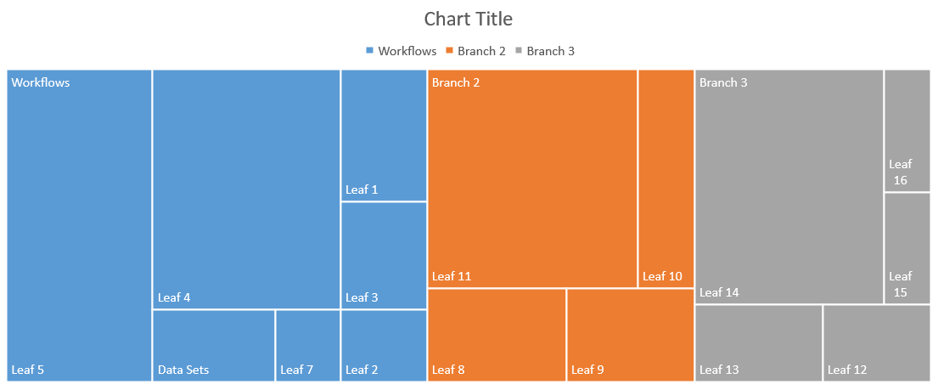
Process Unit Test (Actual)

Slide 12
Business Workflow
Pre-Production
1
2
3
4
5
Sales Cycle
Producer
Script Writer
Edit/Finalize drafts
Casting
Storyboard
6
7
8
9
Production
Sales Cycle
Producer On Set
Crew
Edit/Finalize drafts
Refined Draft
Rough Draft
Anamate
Final Delivery
10
11
12
13
Sales Cycle
Producer in post
Audio/Vioce-overs
Edit/Finalize drafts
Refined Draft
Rough Draft
Editing
Final Delivery
Post-Production

Slide 13
Recommendation (Issue Tracker) (QA) [Graph this][Dashboard chart step by step]
IF we can reduce Workflow errors by 50% then we can raise Capacity(number of video produced in a month)
AND We can free up time to hold learning classes Giving value to Our interns and our culture and a social good to the community!!!
Issues will be problems that we find solutions for and develop documentation on, witch can be used as learning materal (Practical Project)
We will have live projects (live issues can HELP effect cost and the botomline, labed as Middle Prority) and we have died projects (died projects already have a solution or our low prority because they do not effect Production)

Slide 14
Recommendation (Cost Savings) [Graph this][Dashboard chart step by step]
if the average cost of talent is avg $55 hr and we can hire talent to work for avg $25 hr

Slide 15
Recommendation (Account Management) [Graph This][Dashboard chart step by step]
Profiling Our account as well as BDM’s within each account will give as a strategic advantage. We can also profile competition….

Slide 16
Roles/Workflow
Sales Cycle
Content Creator
Campaign Manager
Subject Matter Expert
Assign
Monitor
Write Posts
Curate Content
Respond to support issues assigned to them by "Community Manager"
Approve posts by "Content Creator"
Define campaign ideas
Manage and run campaigns
Collaborate with "Content Creator" to get creative produced
Manage posting schedule
Collaborate with "Community Manager" on posting schedule

Slide 17
Roles/Workflow
Community Manager
Content Creator
Campaign Manager
Subject Matter Expert
Assign
Monitor
Write Posts
Curate Content
Respond to support issues assigned to them by "Community Manager"
Approve posts by "Content Creator"
Define campaign ideas
Manage and run campaigns
Collaborate with "Content Creator" to get creative produced
Manage posting schedule
Collaborate with "Community Manager" on posting schedule

Slide 18
Roles/Workflow
Community Manager
Content Creator
Campaign Manager
Subject Matter Expert
Assign
Monitor
Write Posts
Curate Content
Respond to support issues assigned to them by "Community Manager"
Approve posts by "Content Creator"
Define campaign ideas
Manage and run campaigns
Collaborate with "Content Creator" to get creative produced
Manage posting schedule
Collaborate with "Community Manager" on posting schedule

Slide 19
Recommendation (Admin Fee) (Cost Savings) [Graph this][Dashboard chart step by step]
IF we can reduce cost by 50% then we can raise “pyrmide 15% to 25% or 30% (this rate of change will be applied based of effeminacy kpi of system)

Slide 20
Learning Platform
Issue tracker
Use case
RoadMap
Lesson Plan
Course
Interns

Slide 21
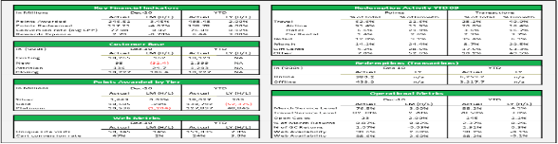
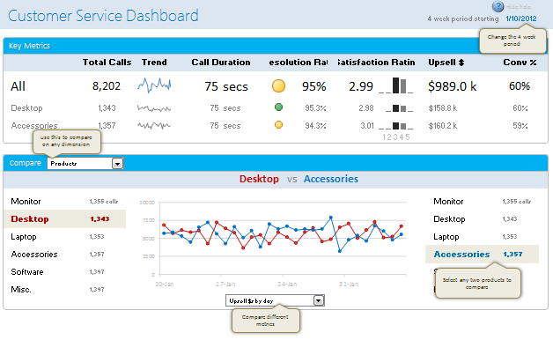
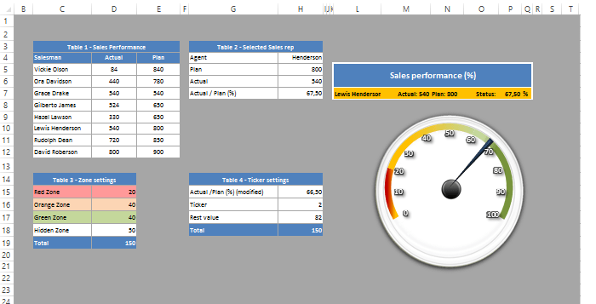
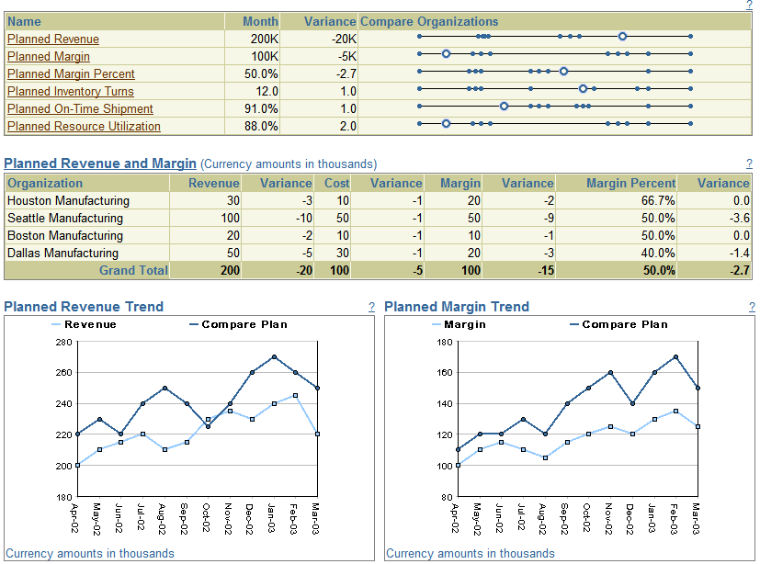
Production Management Dashboard
Managing Director 1
Office Manager
Senior
Junior
Intern
BookKeeper
Account Manager
IT
Internal Budget
Internal Budget
Profit dashboard (Stackolders) |  |  |  | Customer Dashboard (CRM) |  |  |  | Capacity Dashboard ( KPI {Capacity})
Cost |  |  |  | Repeat custmers |  |  |  | KPI
Profit |  |  |  | Net new |  |  |  | PI's
Retention |  |  |  | Testimonals |  |  |  | Metrics
Social Good |  |  |  | Happyness |  |  |  | Targets
Growth |  |  |  | Activity |  |  |  | Trends

Slide 22
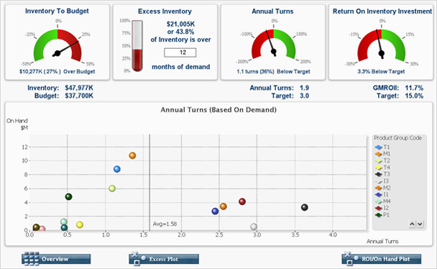
Producer
Producer 1
Producer 2
Producer 3
Producer 4
Producer 3
Producer 5
Senior
Junior
Intern
Internal Budget
48000
Internal Budget
12000
Inventory Tracker
Capacity Tracker

Slide 23
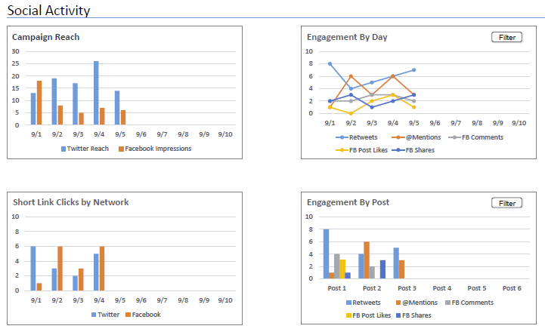
Charts
X1
X2
X3
X4

Slide 24
Other Activities
Asset gallery
Inventory
Hashtags
Video catalog

